Slide 1
Store Application
JingJing Zhuang

Slide 2
Introduction
Purpose

Slide 3
Tech Stack
Framework: .NET
Programming Language: C#, SQL
Database: Azure SQL server
Database Connection: Ado.net
Testing: xUnit test

Slide 4
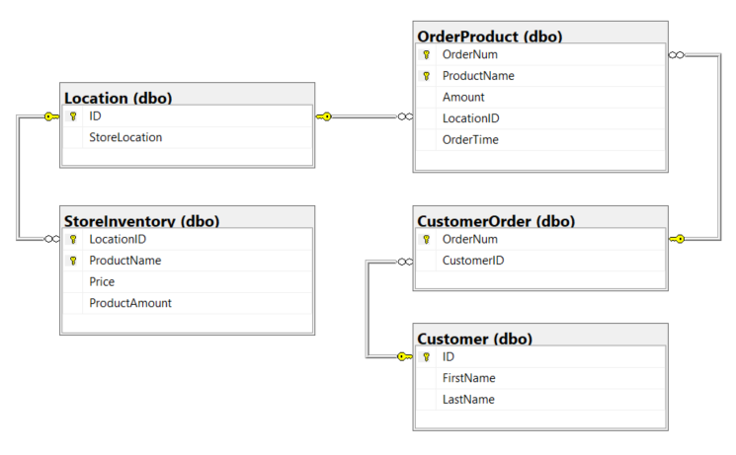
Database Diagram

Slide 5
Demo

Slide 6
Thank you

